Slide 1

Performance & Project Delivery Presentation – Karvendhan Nagaraj
Strategies for effective execution and successful outcomes
Notes:
---

Slide 2
Appraisal Highlights
Notes:
HIM – Report Optimization, CORRO QA – Key Achievements, New Dashboards and Reporting Enhancements, Bulk Upload and User Management Improvements, Team Leadership and Collaboration

Slide 3
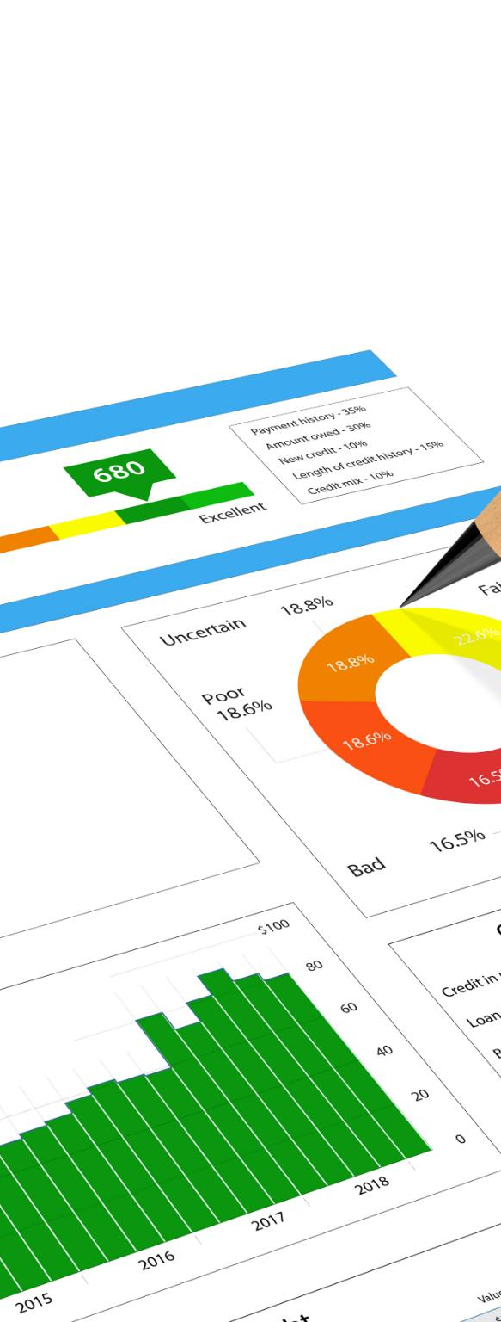
HIM – Report Optimization
Enhanced Usability
  Multiselect filters allow users to apply multiple criteria at once, improving efficiency and ease of use.
Performance Improvement
  Optimization reduces server load by minimizing redundant queries, resulting in faster response times and better scalability.
Comprehensive Testing
  Rigorous testing ensures compatibility across modules and browsers, maintaining a consistent user experience.
Future-Ready Reporting
  This optimization lays groundwork for advanced features like dynamic dashboards and sophisticated analytics.
Notes:
The HIM report optimization initiative focused on enhancing usability and performance through the implementation of a multiselect filter feature. This improvement allowed users to apply multiple criteria simultaneously, reducing the time spent navigating individual filters and improving overall efficiency. By streamlining the filtering process, the reporting system became more intuitive and user-friendly, which is critical for large-scale data analysis environments. Additionally, the optimization reduced server-side load by minimizing redundant queries, leading to faster response times and improved scalability. The project also involved rigorous testing to ensure compatibility across different modules and browsers, thereby maintaining consistency in user experience. This enhancement not only addressed existing pain points but also laid the foundation for future reporting capabilities, such as dynamic dashboards and advanced analytics. The multiselect filter implementation demonstrates a commitment to continuous improvement and aligns with organizational goals of delivering high-performance, user-centric solutions.

Slide 4

CORRO QA – Key Achievements
Code Optimization and Architecture
  Application code was optimized for cleaner architecture, improving maintainability and reducing redundancy.
Database Storage and Performance
  Database optimization reduced storage from 10GB to 2GB, enhancing query speed and lowering costs.
Project Creation Time Reduction
  Project creation time was cut from six days to two hours through workflow streamlining and automation.
Modernization and Scalability
  MySQL stored procedure optimization and codebase revamp enhanced system scalability and reliability.
Notes:
The CORRO QA initiative delivered significant technical and operational improvements across multiple dimensions. First, the entire application code underwent optimization, resulting in cleaner architecture and improved maintainability. Centralized custom field rendering and option loading mechanisms were introduced, reducing redundancy and ensuring consistent behavior across modules. Database optimization was a major milestone, shrinking storage requirements from 10GB to just 2GB, which improved query performance and reduced infrastructure costs. Another notable achievement was reducing project creation time from six days to just two hours, thanks to streamlined workflows and automation. The team also implemented MySQL stored procedure optimization and revamped the codebase to support modern standards. These efforts collectively enhanced system reliability, scalability, and user experience. By addressing critical bottlenecks and introducing best practices, CORRO QA positioned the platform for future growth and innovation.

Slide 5
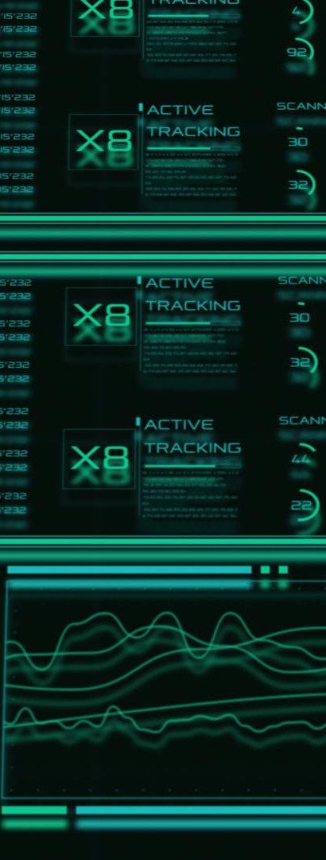
New Dashboards and Reporting Enhancements
Comprehensive Dashboard Suite
  New dashboards provide actionable insights via audit results, analytics, and performance metrics in intuitive layouts.
Enhanced Report Customization
  Column hide/show features in reports improve readability and allow user-specific customization.
Optimized Report Performance
  Server-side processing accelerates weekly reports and auditor projections with accurate filtering.
Centralized Operational Intelligence
  Dashboards integrate advanced filtering and dynamic components to support strategic planning and improvement.
Notes:
The introduction of new dashboards marked a significant leap in data visualization and decision-making capabilities. Key dashboards included Audit Results and Final Outcomes, Analytics Overview, Auditor Performance, Representative Performance, and Error Category analysis. These dashboards provided stakeholders with actionable insights through intuitive layouts and interactive elements. Enhancements to Team and My Reports included column hide/show functionality, improving readability and customization for end-users. Weekly reports and auditor projections were optimized for server-side processing, ensuring faster load times and accurate filtering. These improvements not only streamlined reporting workflows but also empowered managers and auditors to monitor performance trends effectively. By integrating advanced filtering and dynamic components, the dashboards now serve as a central hub for operational intelligence, supporting strategic planning and continuous improvement initiatives.

Slide 6
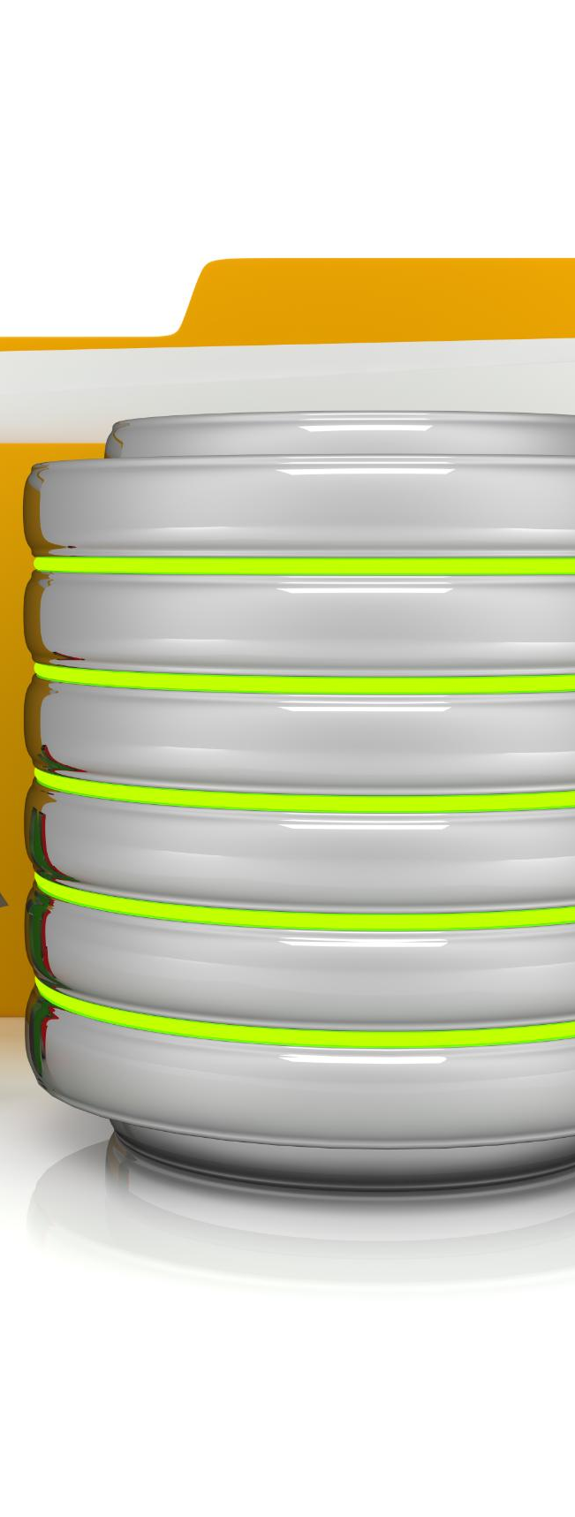
Bulk Upload and User Management Improvements
Enhanced Bulk Upload
  Enhanced bulk upload eliminates errors and speeds up data ingestion with robust validation and error-free outputs.
Improved Data Accuracy
  New validation mechanisms reduce turnaround time and ensure high accuracy in data processing and chart generation.
User Management Upgrades
  User management improvements include advanced filters, server-side data tables, and bulk upload support for scalability.
System Efficiency and Scalability
  Focus on usability and performance helps teams handle large datasets and users without sacrificing speed or accuracy.
Notes:
Bulk upload functionality was enhanced to eliminate errors and accelerate data ingestion processes. Previously, auditors faced delays and inconsistencies during uploads, but the new implementation introduced robust validation mechanisms and error-free chart generation. This improvement significantly reduced turnaround time and improved data accuracy. In parallel, user management underwent a major upgrade with advanced filtering options, server-side data tables, and bulk upload support. These enhancements simplified administrative tasks, improved scalability, and ensured compliance with organizational standards. By focusing on usability and performance, these changes contributed to a more efficient and reliable system, enabling teams to handle large datasets and user bases without compromising on speed or accuracy.

Slide 7

Team Leadership and Collaboration
Task Management and Monitoring
  Assigning tasks and monitoring progress ensured organized workflow and timely project delivery.
Collaborative Environment
  Fostering collaboration boosted productivity and upheld quality standards throughout the project.
Feedback and Support
  Regular feedback sessions and proactive support minimized delays and improved team morale.
Mentoring and Knowledge Sharing
  Mentoring junior developers and promoting best practices strengthened team cohesion and expertise.
Notes:
Effective team coordination was a cornerstone of this appraisal period. Responsibilities included assigning tasks, monitoring progress, conducting code reviews, and providing technical guidance to team members. By fostering a collaborative environment, the team achieved higher productivity and maintained quality standards across deliverables. Regular feedback sessions and proactive support ensured that challenges were addressed promptly, minimizing delays and enhancing morale. Leadership efforts also extended to mentoring junior developers, promoting best practices, and encouraging knowledge sharing. These initiatives not only strengthened team cohesion but also contributed to the successful execution of complex projects within tight timelines.

Slide 8
Personal Development and Future Goals
Notes:
Strengths and Core Competencies, Areas of Improvement and Learning Plan, Next Year Goals and Strategic Vision

Slide 9

Strengths and Core Competencies
Multi-perspective Analysis
  Tasks are analyzed proactively from positive, negative, and user-friendly viewpoints before implementation.
Innovation and Added Value
  Enhancing core functionalities beyond client needs demonstrates innovation and customer-centric mindset.
Optimized Development
  Expertise in developing optimized code and database structures ensures high performance and scalability.
Analytical Problem-solving
  Strong analytical skills help identify root causes and apply effective problem-solving techniques.
Notes:
Key strengths demonstrated during this period include a proactive approach to analyzing tasks from multiple perspectives—considering positive, negative, and user-friendly aspects before implementation. The ability to enhance core functionalities by adding value beyond client requirements showcased innovation and customer-centric thinking. Expertise in developing optimized code and database structures ensured high performance and scalability. Strong analytical skills facilitated root cause identification and effective problem-solving, while adherence to structured coding practices maintained consistency and reduced technical debt. These competencies collectively contributed to delivering robust, efficient, and user-focused solutions.

Slide 10

Areas of Improvement and Learning Plan
Communication and Stakeholder Skills
  Improving communication and stakeholder management is essential for effective collaboration and project success.
Technical Skill Development
  Mastering Node.js, TypeScript, React, AI, and PostgreSQL aligns with current industry technology trends.
Advanced Monitoring and Quality Tools
  Utilizing Grafana and SonarQube enhances system monitoring, reliability, and code quality.
AI Integration for Automation
  Incorporating AI-driven features supports automation and predictive analytics in workflows.
Notes:
Continuous improvement remains a priority, with a focus on enhancing communication skills and stakeholder management capabilities. Technical learning goals include mastering Node.js, TypeScript, React, AI technologies, and PostgreSQL to stay aligned with evolving industry trends. Additionally, exploring advanced tools such as Grafana for monitoring and SonarQube for code quality will strengthen system reliability and maintainability. Emphasis will also be placed on understanding AI-driven features and integrating them into workflows for automation and predictive analytics. These initiatives aim to broaden technical expertise and improve cross-functional collaboration.

Slide 11

Next Year Goals and Strategic Vision
Advanced Technology Development
  Driving CorroPro development by leveraging cutting-edge technologies to enhance product capabilities and innovation.
Monitoring Solutions Implementation
  Implementing advanced monitoring tools like Grafana and SonarQube to ensure system performance and reliability.
AI for Automation
  Exploring AI capabilities to enable automation and intelligent decision-making within organizational processes.
Infrastructure and Scalability
  Maintaining server infrastructure, optimizing performance, and adopting emerging frameworks to improve scalability.
Notes:
Future objectives include driving CorroPro development with cutting-edge technologies and implementing advanced monitoring solutions using Grafana and SonarQube. Exploring AI capabilities for automation and intelligent decision-making will be a key focus area. Additional goals involve maintaining server infrastructure, optimizing performance, and adopting emerging frameworks to enhance scalability. By aligning these initiatives with organizational priorities, the aim is to deliver innovative solutions that improve operational efficiency and create long-term value for stakeholders.

Slide 12


Thank You
For Your Consideration & Support
I sincerely appreciate the opportunity to present my achievements and contributions. I look forward to continuing to contribute more significantly to the organization's quality assurance success and achieving the goals outlined in this review.
Notes:
The appraisal concludes with a note of gratitude, acknowledging the opportunity to present achievements and future plans. The employee expresses sincere appreciation for the support received and reiterates a commitment to contributing to organizational success. This closing statement reinforces the collaborative spirit and dedication to quality that underpin the employee’s professional journey. By maintaining a focus on excellence and continuous improvement, the employee aims to strengthen their role as a key resource in quality assurance and drive impactful outcomes in the coming year.

